Slide 1


CASCADING STYLE SHEETS
ADVANCE
CSS is the language we use to style an HTML document.
CSS describes how HTML elements should be displayed.

Slide 2

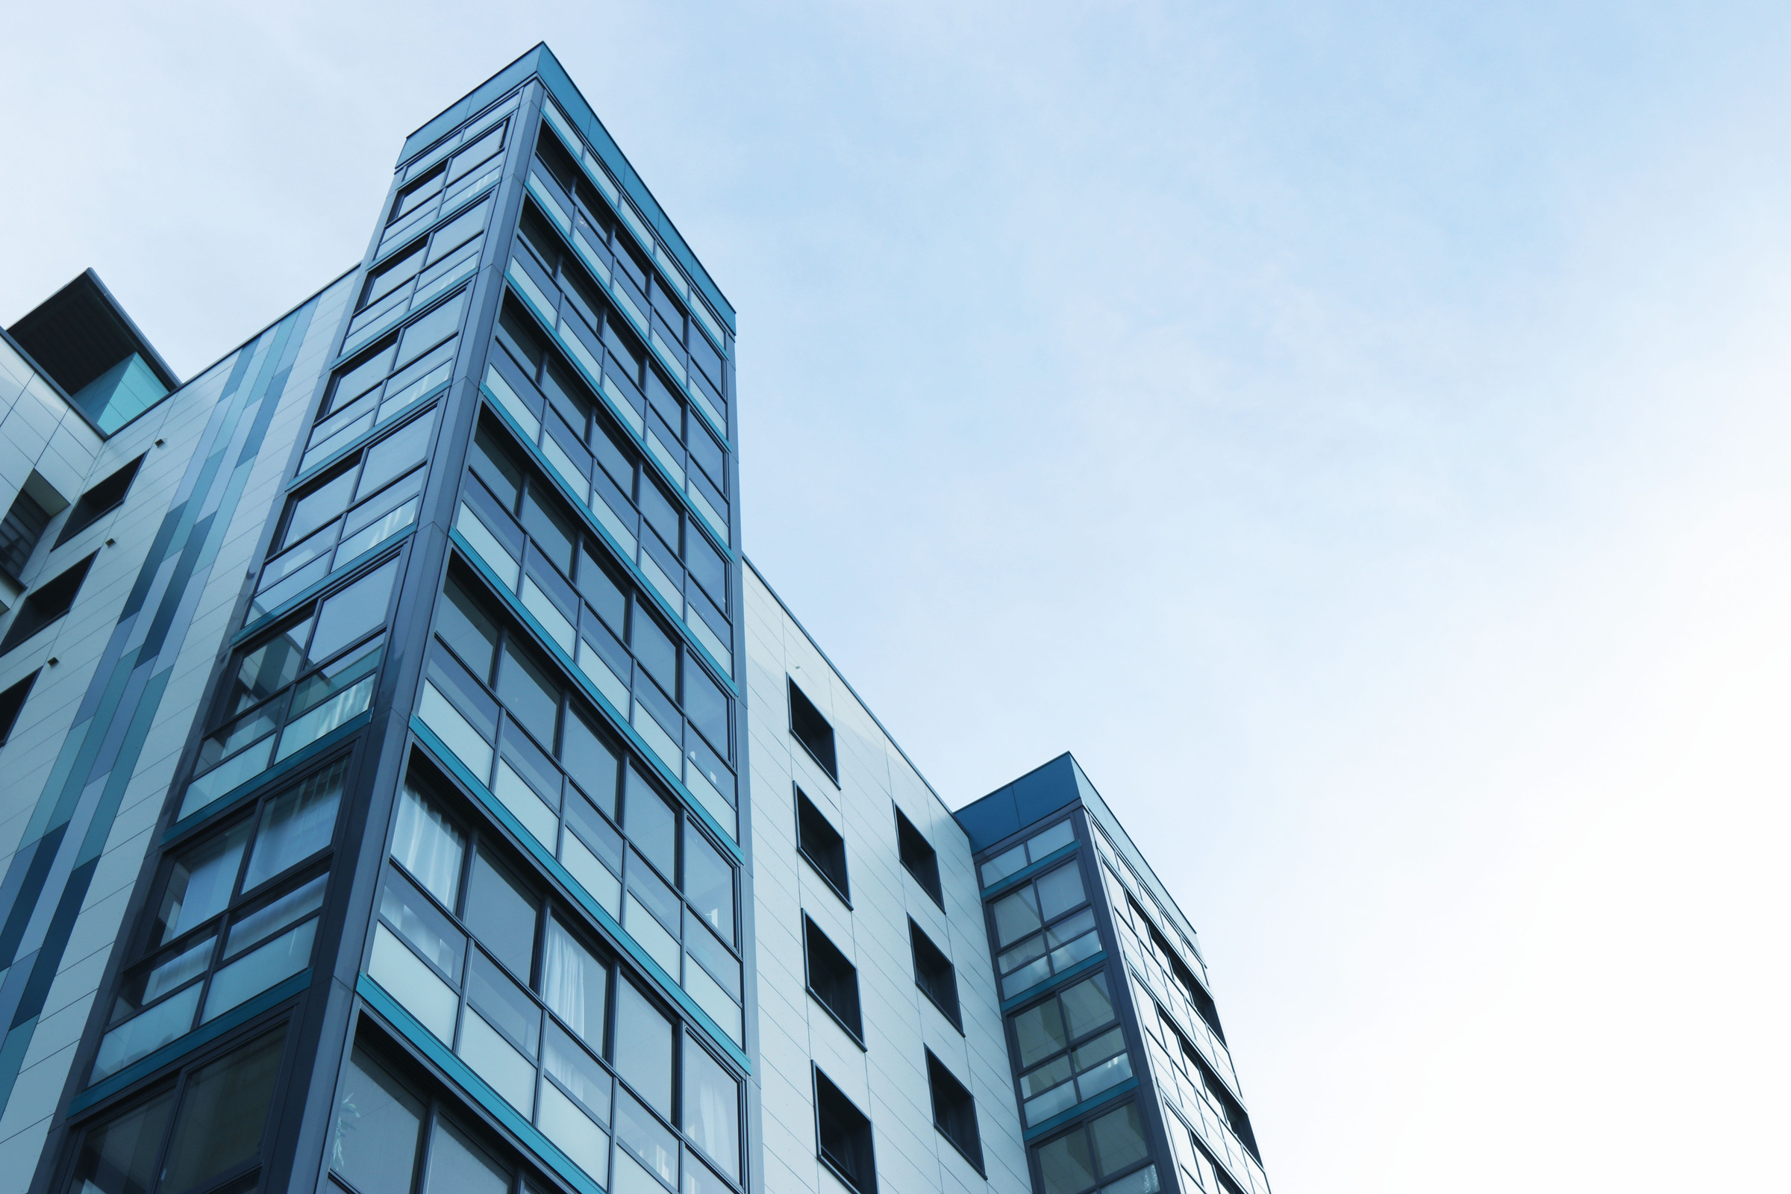

CSS
OVERVIEW
CSS stands for "Cascading Style Sheets." Think of it as the "fashion designer" for your website. It's the magic tool that makes your web pages look fabulous, with all sorts of colors, fonts, and design elements.
So, whether you want your website to look sleek and professional or bold and funky, CSS is the tool that can help you make it happen. With CSS, you can make your website stand out from the crowd and express your unique style.

Slide 3

PPT
CONTENT
Box Model
Grid layout
Animations
Media Query

Slide 4
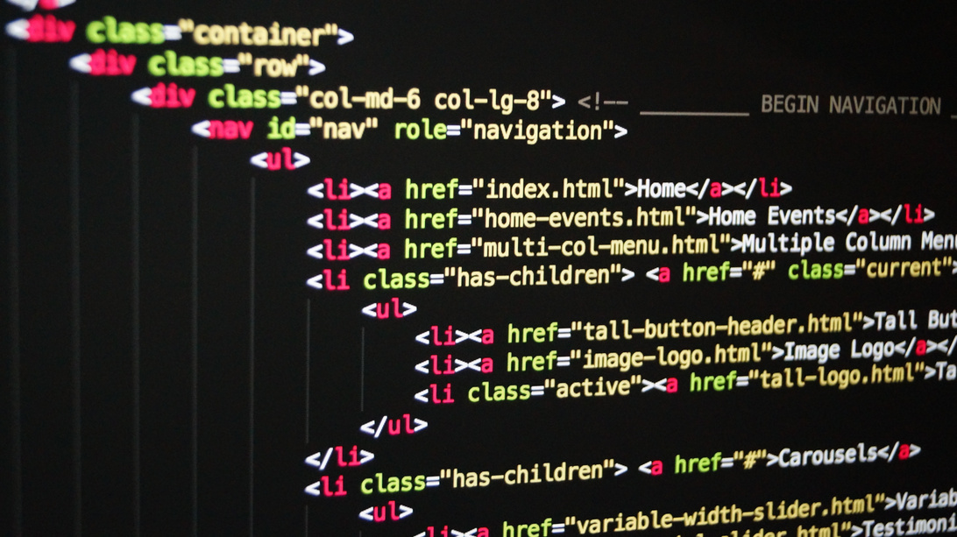

BOX MODEL
The CSS box model as a whole applies to block boxes and defines how the different parts of a box — margin, border, padding, and content — work together to create a box that you can see on a page. Inline boxes use just some of the behavior defined in the box model.
Block and inline boxes
In CSS we have several types of boxes that generally fit into the categories of block boxes and inline boxes. The type refers to how the box behaves in terms of page flow and in relation to other boxes on the page. Boxes have an inner display type and an outer display type.

Slide 5
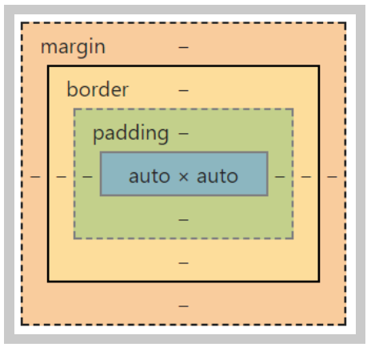
BOX MODEL
Making up a block box in CSS we have the:
Content box: The area where your content is displayed; size it using properties like inline-size and block-size or width and height.
Padding box: The padding sits around the content as white space; size it using padding and related properties.
Border box: The border box wraps the content and any padding; size it using border and related properties.
Margin box: The margin is the outermost layer, wrapping the content, padding, and border as whitespace between this box and other elements; size it using margin and related properties.

Slide 6


ABOUT
BORDER
1. box-shadow: 10px 10px 5px Pink;
2. border-top-left-radius : 25px;
3. border-top-right-radius : 25px;
4. border-bottom-left-radius : 25px;
5. border-bottom-right-radius : 25px;
ABOUT
TEXT PROPERTIES
1. text-decoration :
2. text-transform : uppercase / lowercase / capitalize;
3. text-shadow : 10px 10px 5px Pink;
4. word-spacing : 10px;
5. letter-spacing : 10px;

Slide 7
BOX MODEL
1. Which of the following property adds padding to the top of an element?
a) height
b) padding-height
c) top
d) padding-top

Slide 8
ANSWER
D

Slide 9
BOX MODEL
2. Which of the following display property value is described by treats the element as inline?
a) inline-block
b) list-item
c) block
d) inline

Slide 10
ANSWER
2. D

Slide 11
BOX MODEL
3. Which of the following property defines the style for the bottom border of an element?
a) border-bottom-style
b) border-collapse
c) border-style-bottom
d) none of the mentioned

Slide 12
ANSWER
3. A

Slide 13
BOX MODEL
4. Which of the following property defines the style for the left border of an element?
a) border-style
b) border-left-style
c) border-left-width
d) border-right

Slide 14
ANSWER
4. B

Slide 15
BOX MODEL
5. Which of the following visibility property value is described by The element is not visible, but the layout of surrounding elements is not affected?
a) visible
b) hidden
c) collapse
d) none of the mentioned

Slide 16
ANSWER
5. B

Slide 17
GRID LAYOUT
The CSS grid layout module excels at dividing a page into major regions or defining the relationship in terms of size, position, and layer, between parts of a control built from HTML primitives.
Like tables, grid layout enables an author to align elements into columns and rows. However, many more layouts are either possible or easier with CSS grid than they were with tables. For example, a grid container's child elements could position themselves so they actually overlap and layer, similar to CSS positioned elements.

Slide 18
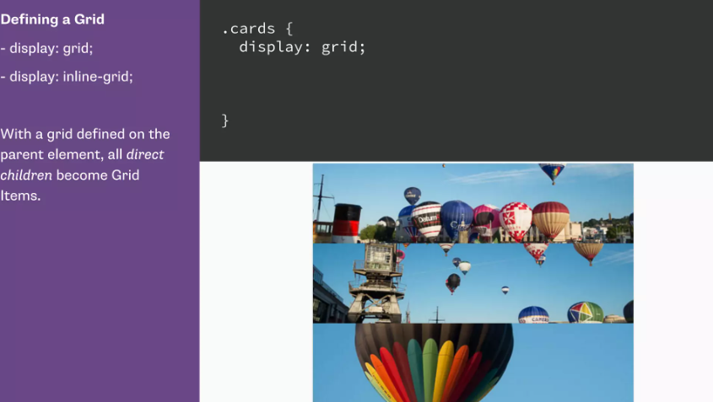

Slide 19
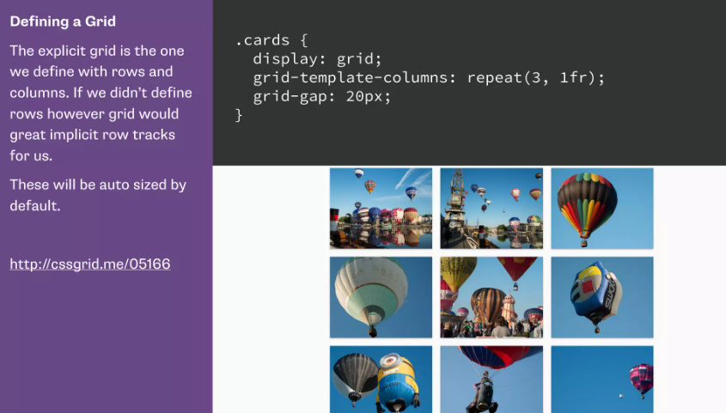

Slide 20
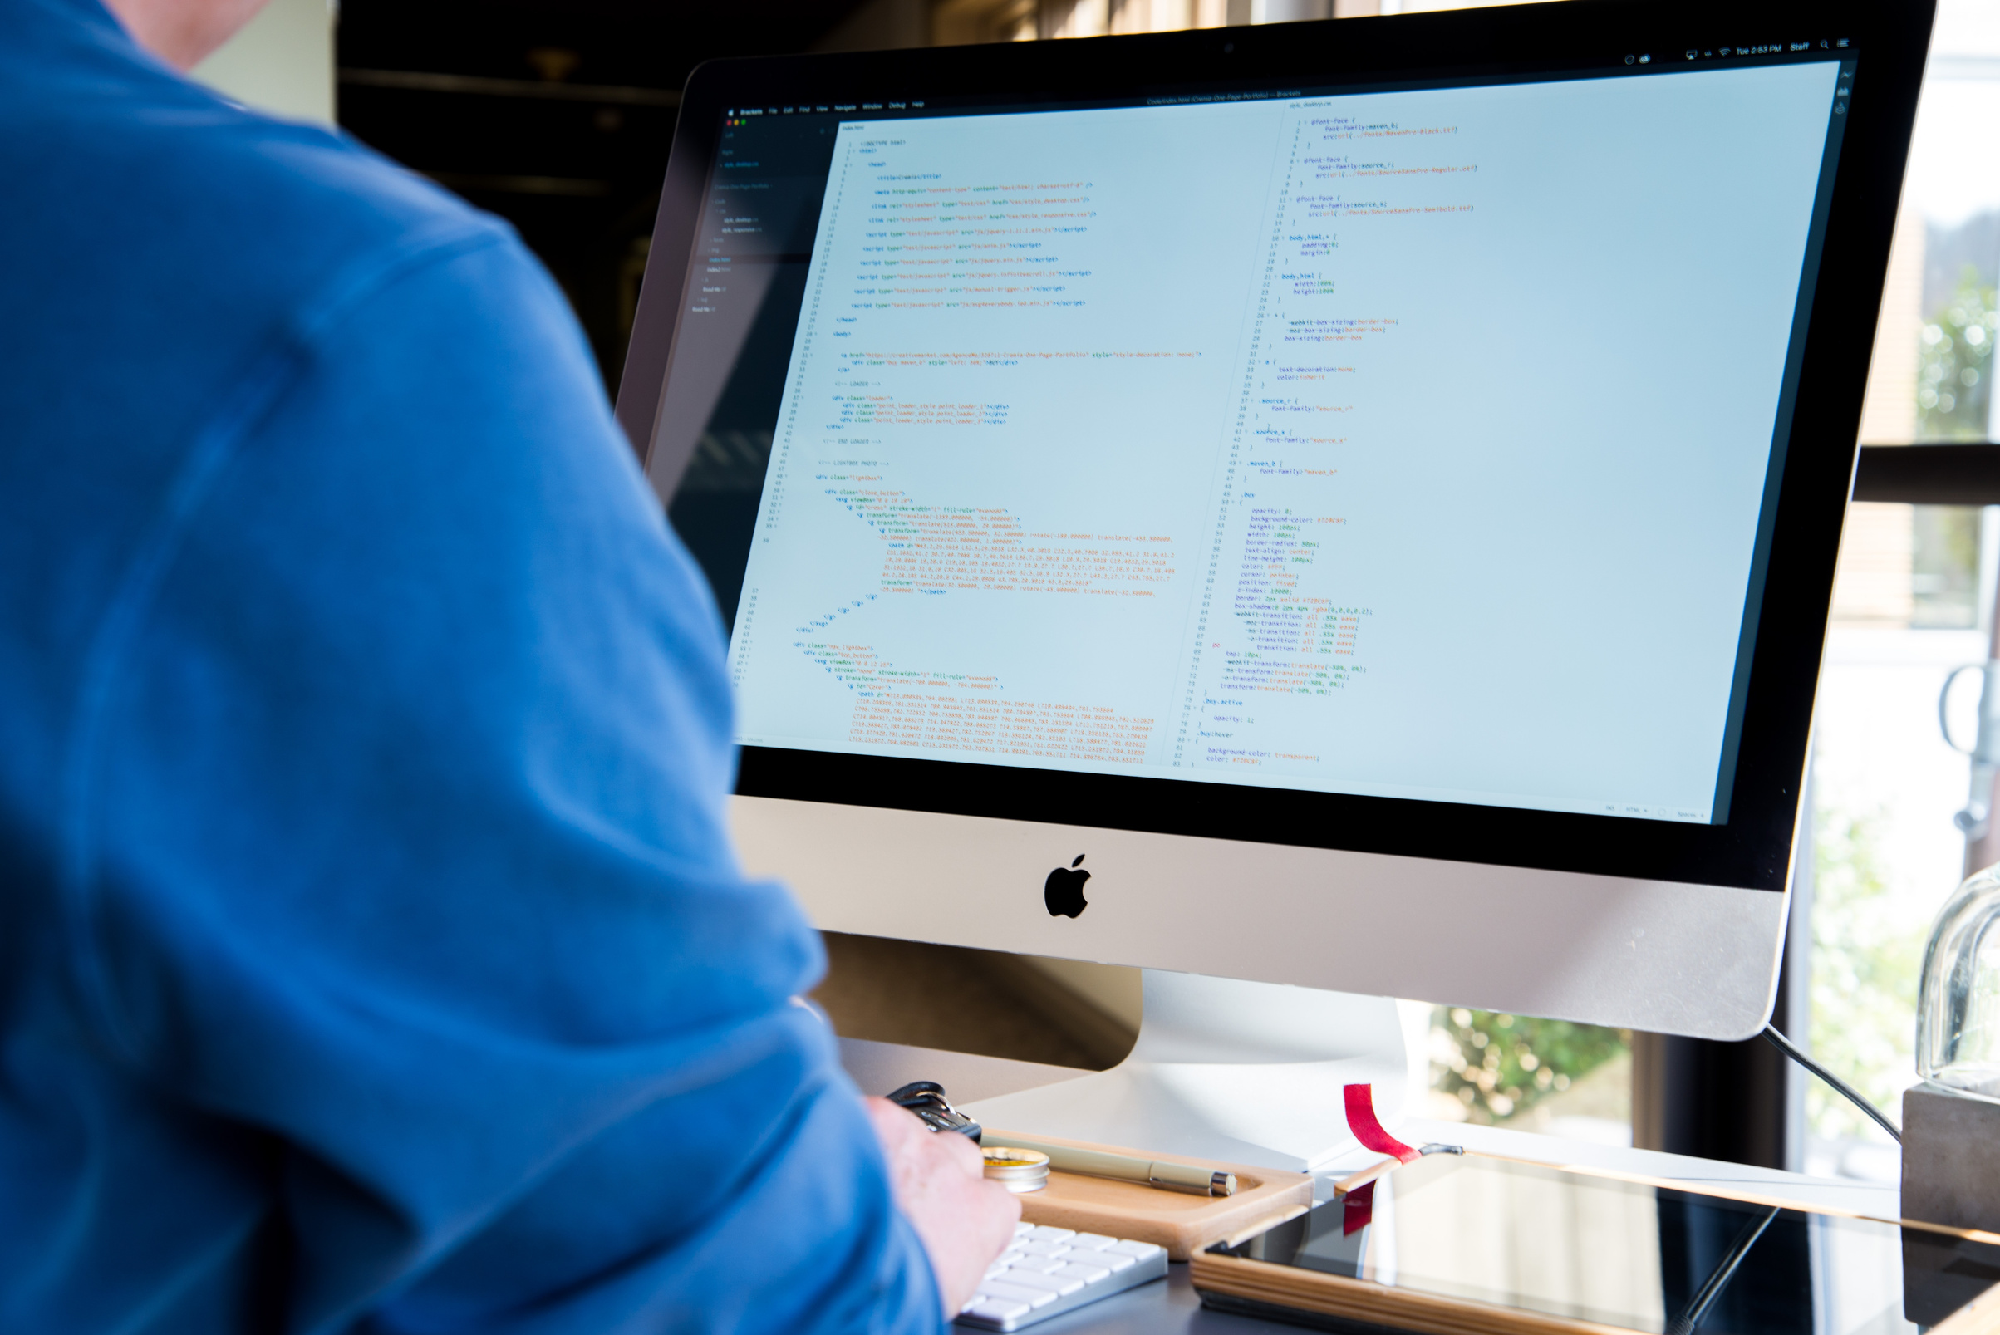
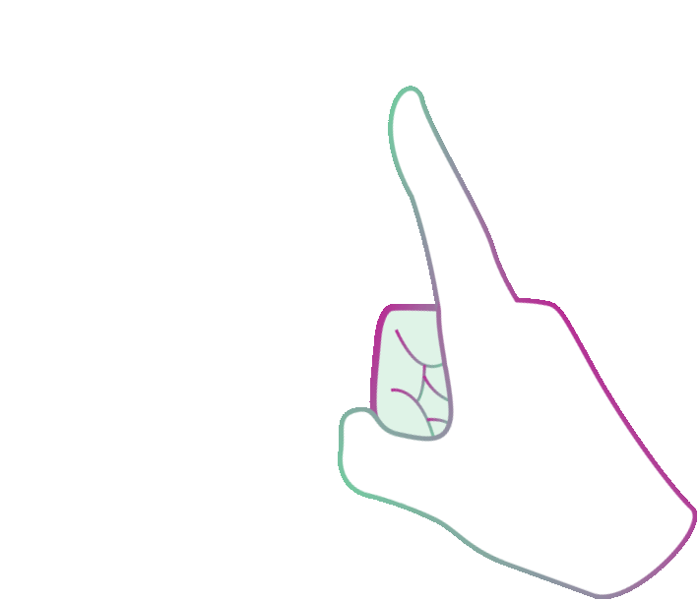
ANIMATIONS
An animation lets an element gradually change from one style to another. You can change as many CSS properties you want, as many times as you want.
To use CSS animation, you must first specify some keyframes for the animation. Keyframes hold what styles the element will have at certain times.
animation-name: AnimationName;
animation-duration: 4s;
animation-delay: 2s;
animation-iteration-count: 1/n/infinite;
animation-direction: reverse / alternate / normal;

Slide 21

@KEYFRAMES RULE
When you specify CSS styles inside the @keyframes rule, the animation will gradually change from the current style to the new style at certain times. To get an animation to work, you must bind the animation to an element.
Step1: Define animation using keyframes
@keyframes AnimationName
{
from {prop:value, prop:value; ....}
to {prop:value, prop:value; ....}
}
Step2: Apply Animation
tagName
{
animation-name : AnimationName;
animation-duration: 5s;
}

Slide 22
ANIMATION QUES
1. Which of the following css property is used to define a delay before an animation starts?
a) delay
b) transition-delay
c) transform-delay
d) none of the mentioned

Slide 23
ANSWER
1. B

Slide 24
ANIMATION QUES
2. Which of the following css property is used to define the time it takes one iteration of an animation to play?
a) control
b) animation-duration
c) transition-duration
d) all of the mentioned

Slide 25
ANSWER
2. C

Slide 26
ANIMATION QUES
3.Which of the following css property is used to define a delay before an animation starts?
a) transform-delay
b) delay-function
c) delay-animation
d) animation-delay

Slide 27
ANSWER
3. D

Slide 28
ANIMATION QUES
4. Which of the following css property is used to define the time it takes one iteration of an animation to play?
a) animation-duration
b) animation-time
c) animation-value
d) none of the mentioned

Slide 29
ANSWER
4. A

Slide 30
MEDIA QUERY
Media queries can be used to check many things, such as:
width and height of the viewport
width and height of the device
orientation (is the tablet/phone in landscape or portrait mode?)
resolution
Using media queries are a popular technique for delivering a tailored style sheet to desktops, laptops, tablets, and mobile phones (such as iPhone and Android phones).

Slide 31
MEDIA QUERY SYNTAX
A media query consists of a media type and can contain one or more expressions, which resolve to either true or false.
@media not|only mediatype and (expressions) {
CSS-Code;
}
The result of the query is true if the specified media type matches the type of device the document is being displayed on and all expressions in the media query are true. When a media query is true, the corresponding style sheet or style rules are applied, following the normal cascading rules.
Unless you use the not or only operators, the media type is optional and the all type will be implied.

Slide 32
MEDIA QUERY SYNTAX
A media query consists of a media type and can contain one or more expressions, which resolve to either true or false.
@media not|only mediatype and (expressions) {
CSS-Code;
}
The result of the query is true if the specified media type matches the type of device the document is being displayed on and all expressions in the media query are true. When a media query is true, the corresponding style sheet or style rules are applied, following the normal cascading rules.
Unless you use the not or only operators, the media type is optional and the all type will be implied.

Slide 33
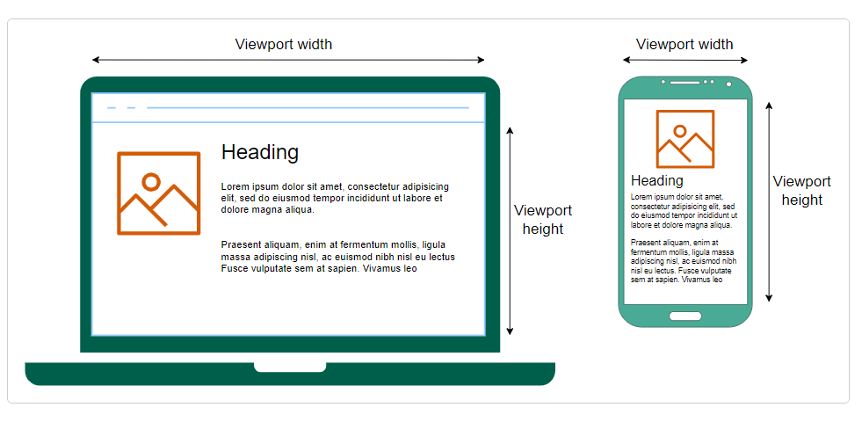
MEDIA QUERY

Slide 34

THANK YOU
By Vasundhra

